Slide 1
usegalaxy.no tools and workflows
Thu-Hien TO, NMBU
ELIXIR Norway, Norwegian e-infrastructure for Life Sciences and usegalaxy.no

Slide 2
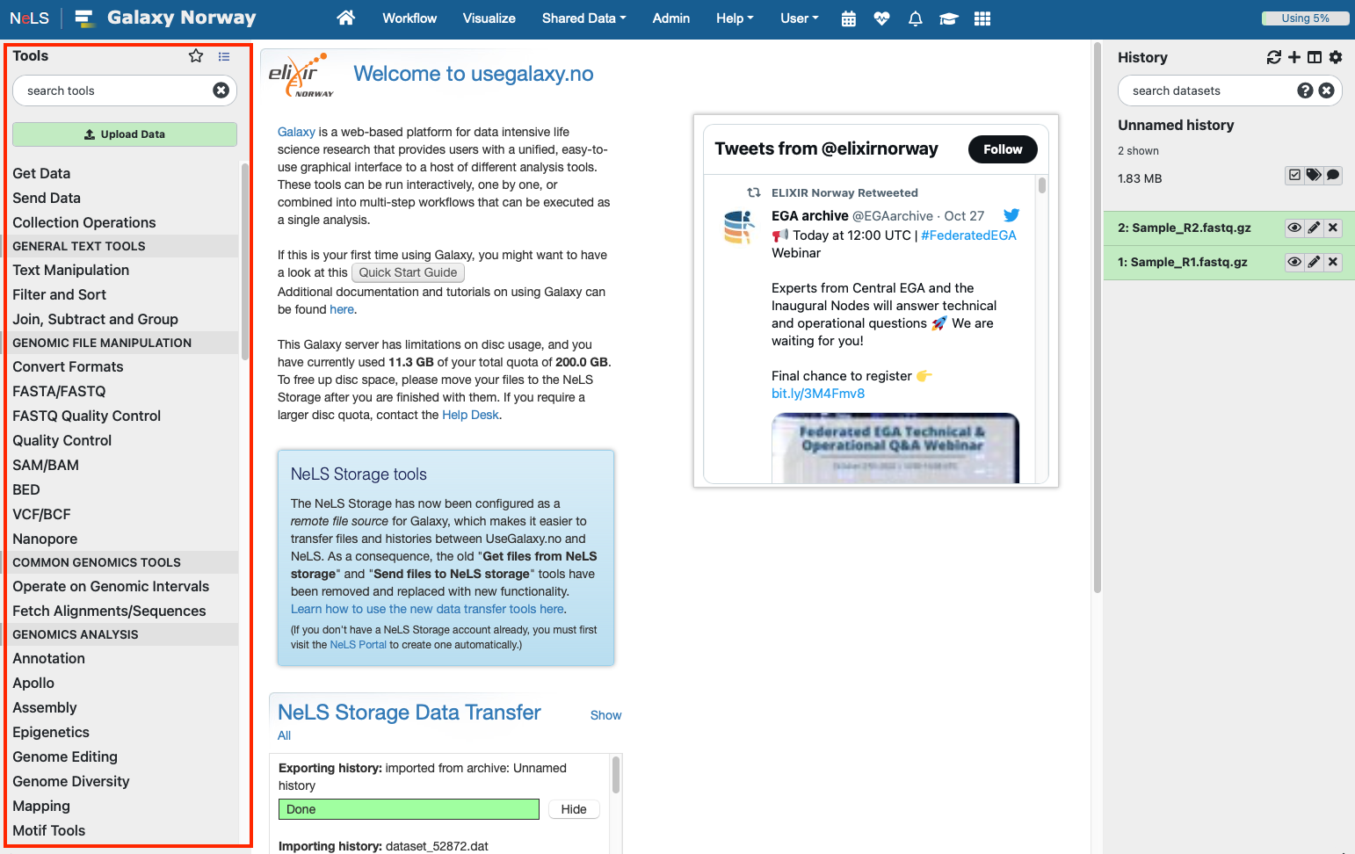
Galaxy tool panel
Tools are available from the Tool menu
Organised under sub-menus
Possible to browse and search by name
You can make your own list of favourite tools
Notes:
All the tools available on the particular Galaxy server are listed in the Tools panel on the left-hand side.
The tools are grouped into sections (categories) and you can click on a section header to show which tools it contains. You can also search for tools by name or keywords using the search box at the top of the panel.

Slide 3
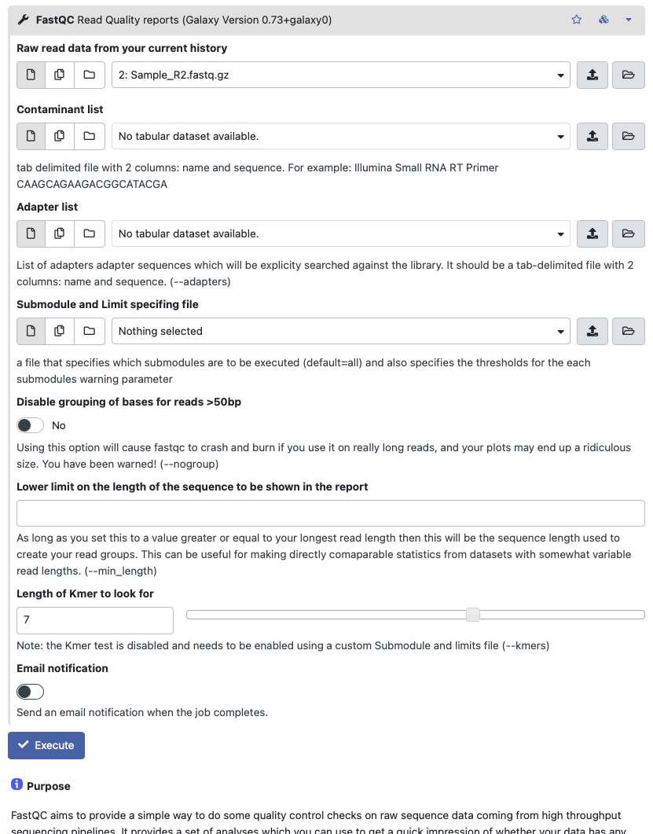
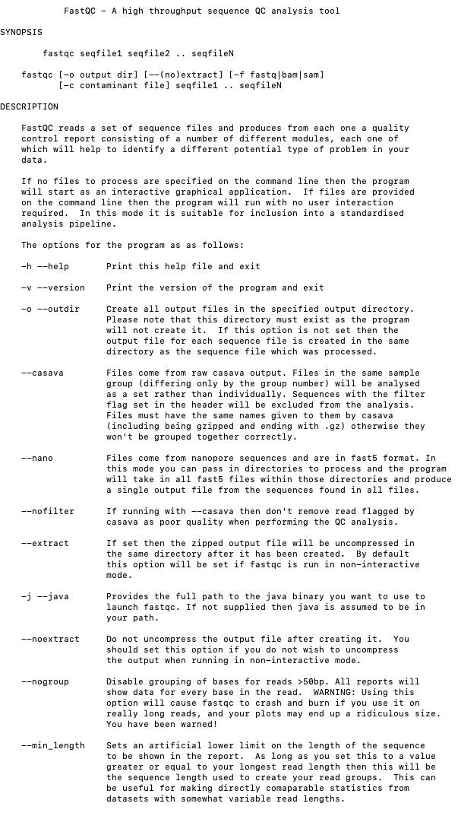
Galaxy tools vs command line tools
Command line tools are wrapped into Galaxy so they become accessible with a GUI
Some Galaxy tools may have reduced the number of optional parameter settings for the tool

Slide 4
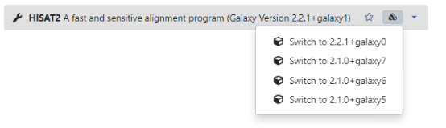
Tool version
For the sake of reproducibility, usegalaxy allows different (legacy) versions of a tool
Notes:
To support reproducibility as software is being continuously updated, Galaxy allows different (legacy) versions of the same tool to be installed, and users can decide for themselves which version they would like to use for their analyses.
When you select a tool from the Tools panel, its version number will be displayed behind the tool name in the header at the top of the tool form page.
If there are multiple versions of the tool available, an icon resembling "stacked cubes" will appear to the right, and you can click on this to bring up a menu which allows you to select a different version.
Be aware, however, that the version numbers shown are internal to Galaxy, and these might not necessarily correspond directly to the numbering used by the original developers of the tool.

Slide 5
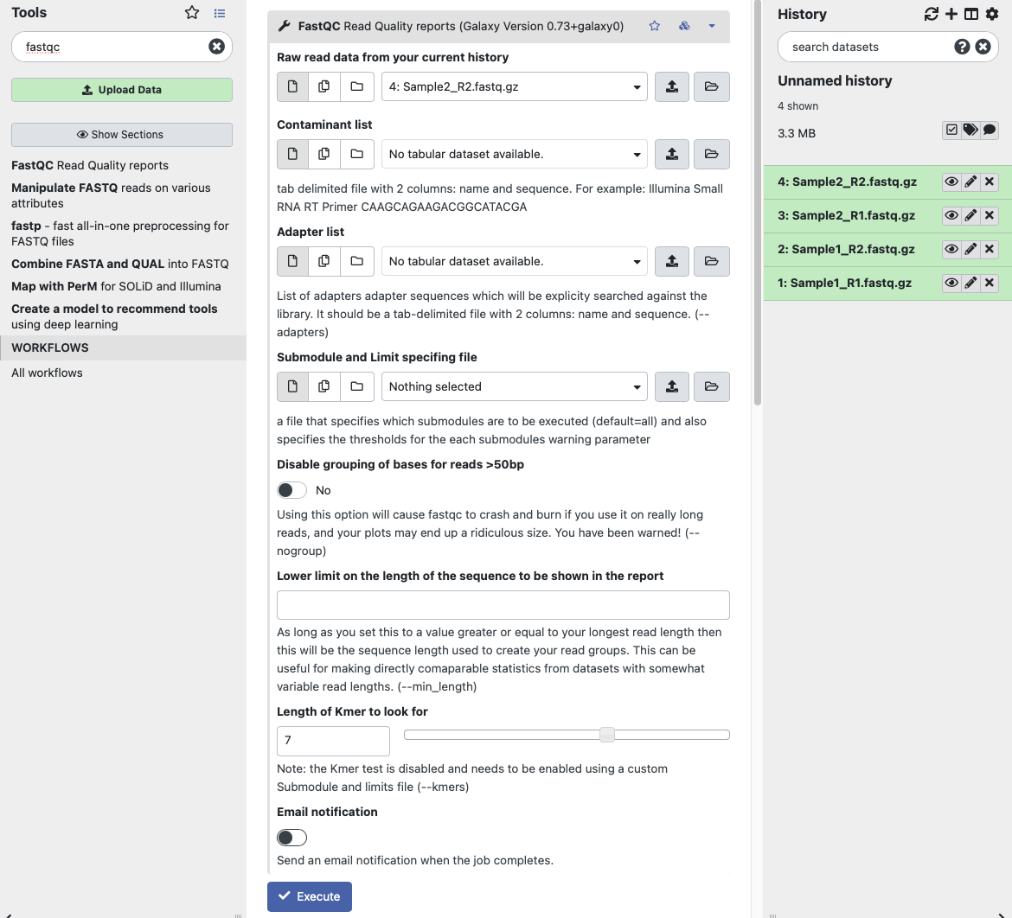
Running tools in Galaxy
Choose parameter settings
Select input files
Most tools comes with a detailed description of usage
Notes:
The most important parameters are the input data parameters that allow you to select which dataset(s) from your history to apply the tool to.
Input data parameters are preceeded by buttons (explained below) which let you choose if you want to run with a single input dataset, multiple inputs selected individually, or a collection of input datasets.
Note that only datasets that have the correct data format will be displayed in the form, so if a particular input parameter appears empty, it probably means that your history contains no datasets or collections of the required type.

Slide 6
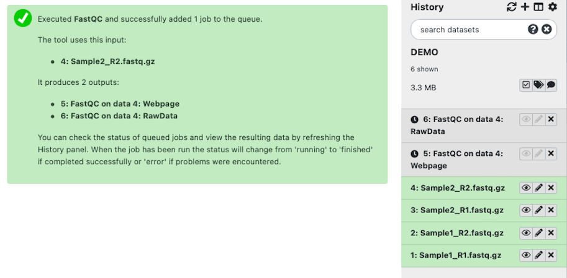
Running tools in Galaxy
Grey status: jobs are waiting to run

Slide 7
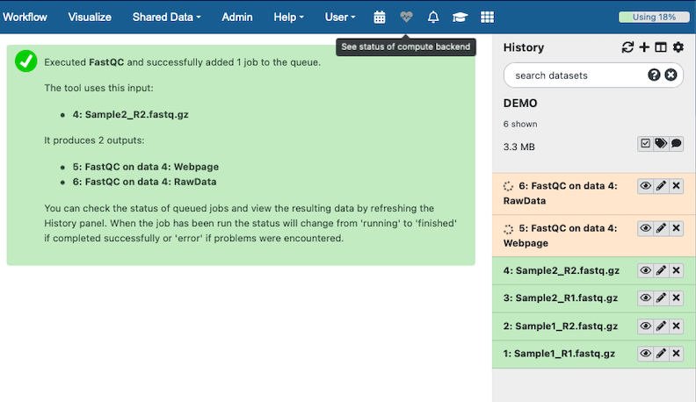
Running tools in Galaxy
Yellow status: jobs are running in the backend
You can cancel a running job if you want

Slide 8
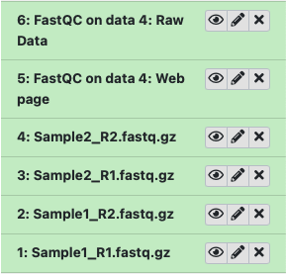
Running tools in Galaxy
Green status: jobs finished

Slide 9
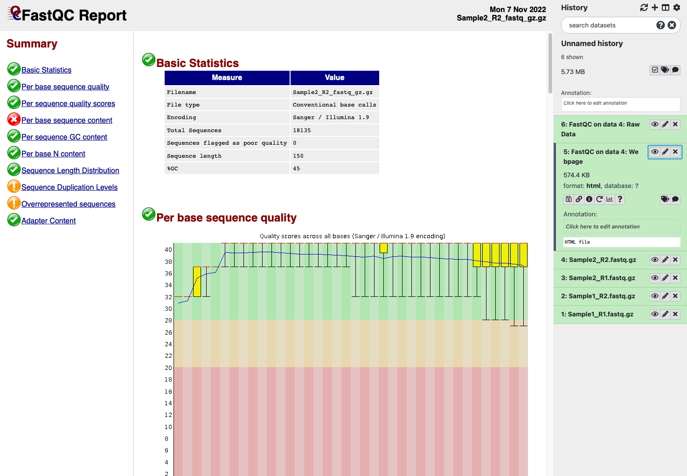
Tool output
Default output name: (tool_name) on (data i): (data type)
It is possible to preview the output (result) in the main window

Slide 10
Tool output
Default output name: (tool_name) on (data i): (data type)
or download the dataset or get download link
Notes:
We can see only the some first lines of the standard output

Slide 11
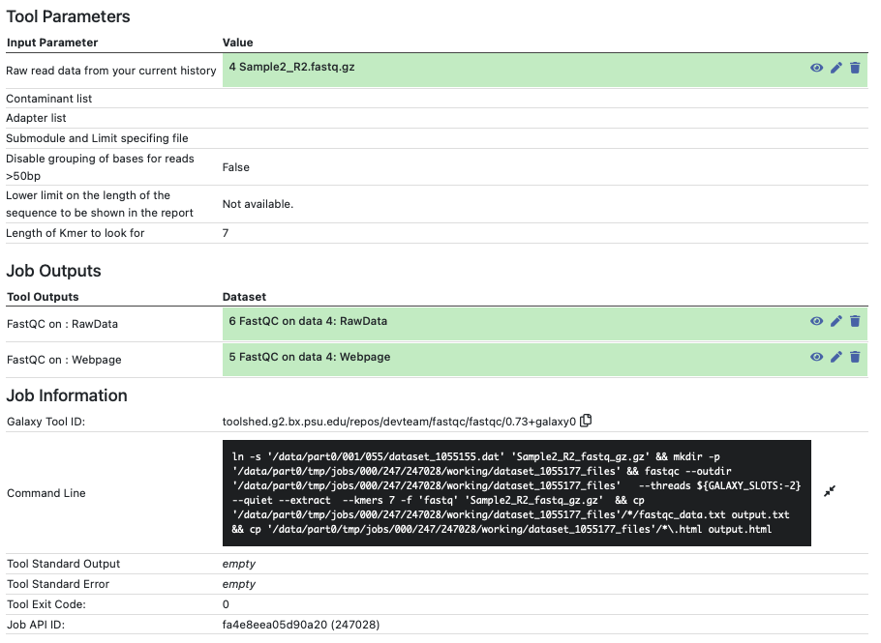
Tool output: view job details
Report input files and parameters
Tool ID
Command line run in the back-end
Job ID

Slide 12
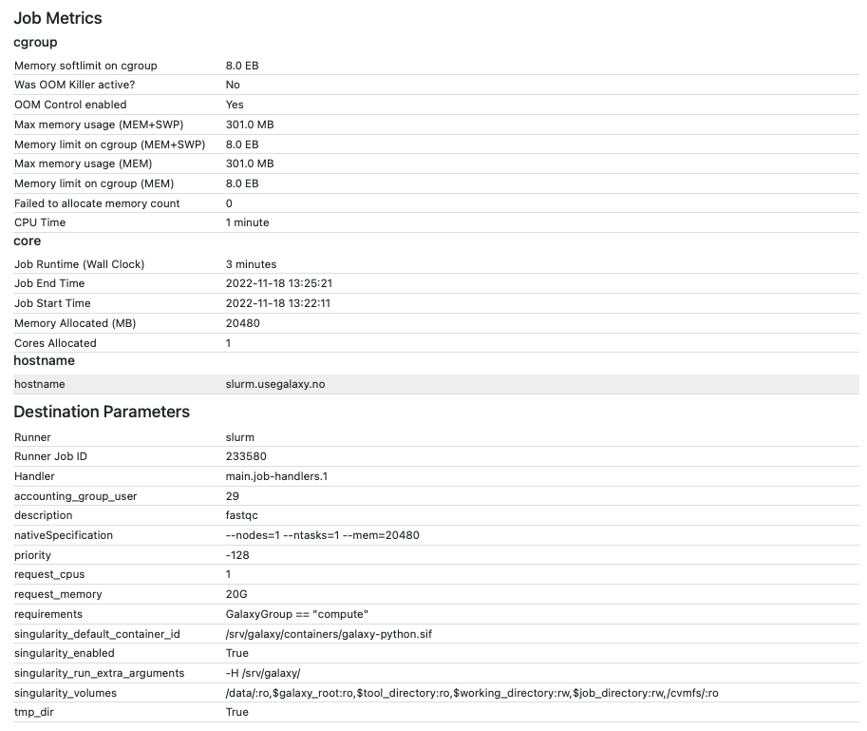
Tool output: view job details
Running time
Number of cpus and how much memory requested
etc

Slide 13
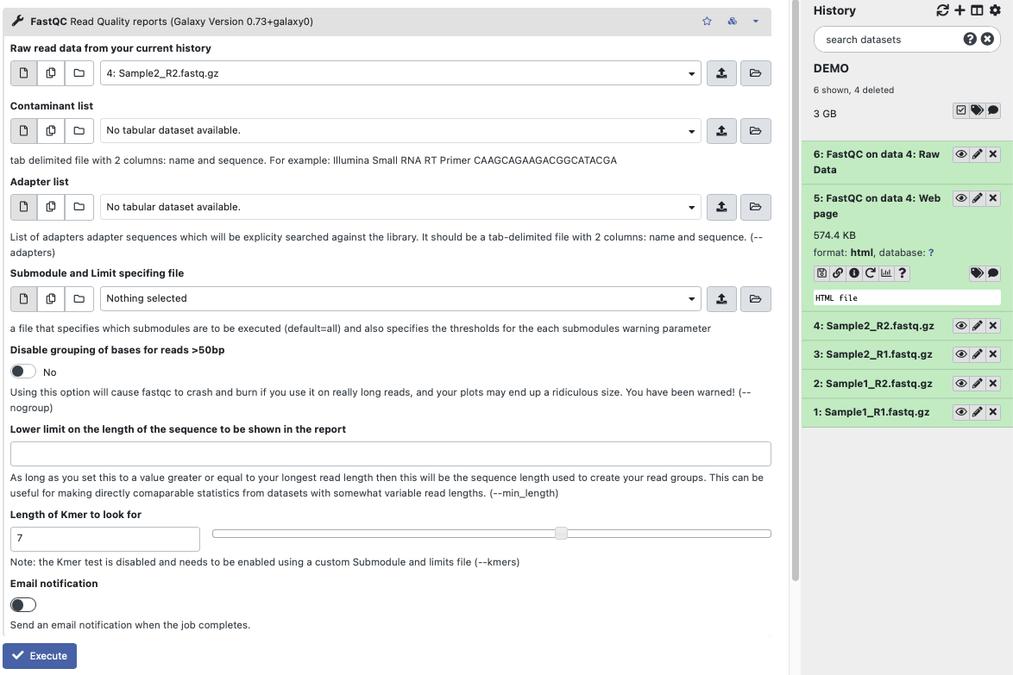
Rerun a job
All input files and parameters are reset automatically

Slide 14
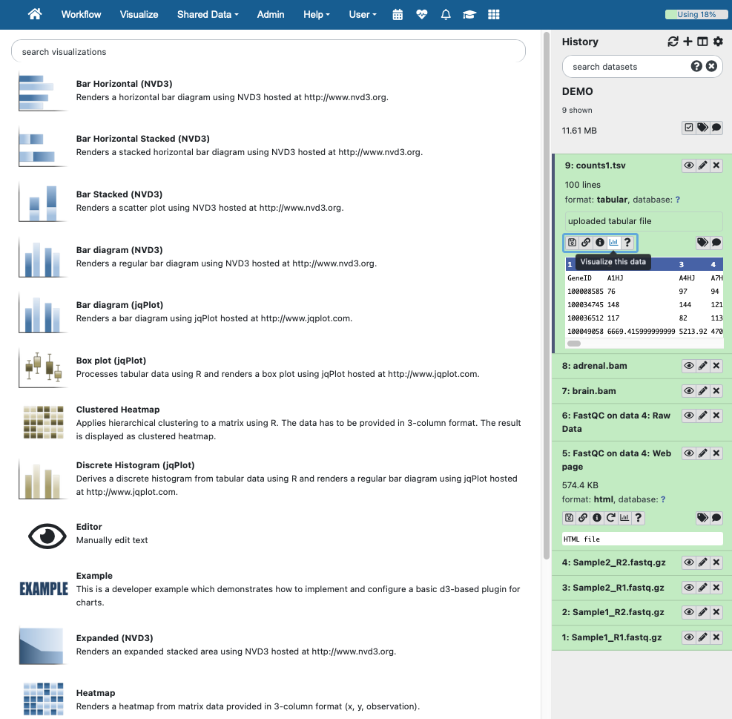
Visualize data
Depending on the data type, there are different tools to visualize them
Example of tabular file:
- Several types of plot
- Editor to manually edit text

Slide 15
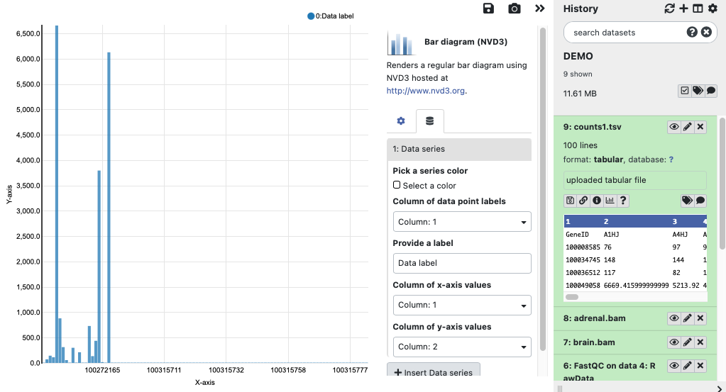
Visualize data
Example of bar diagram for tabular file:
- Can select column for x-axis and y-axis

Slide 16
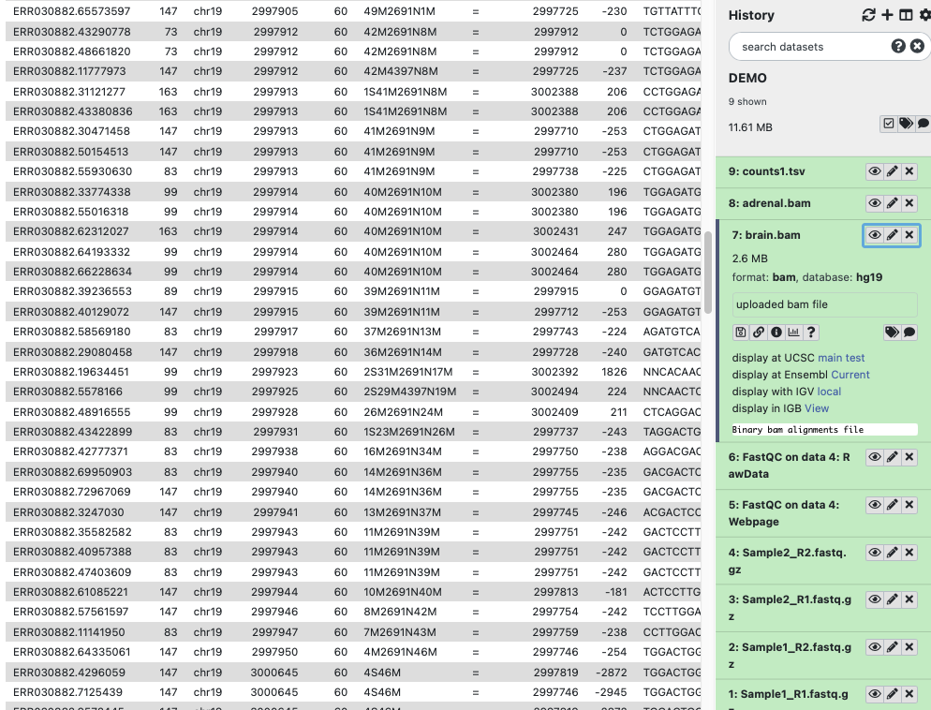
Visualize data
Example of visualize an alignment bam data

Slide 17
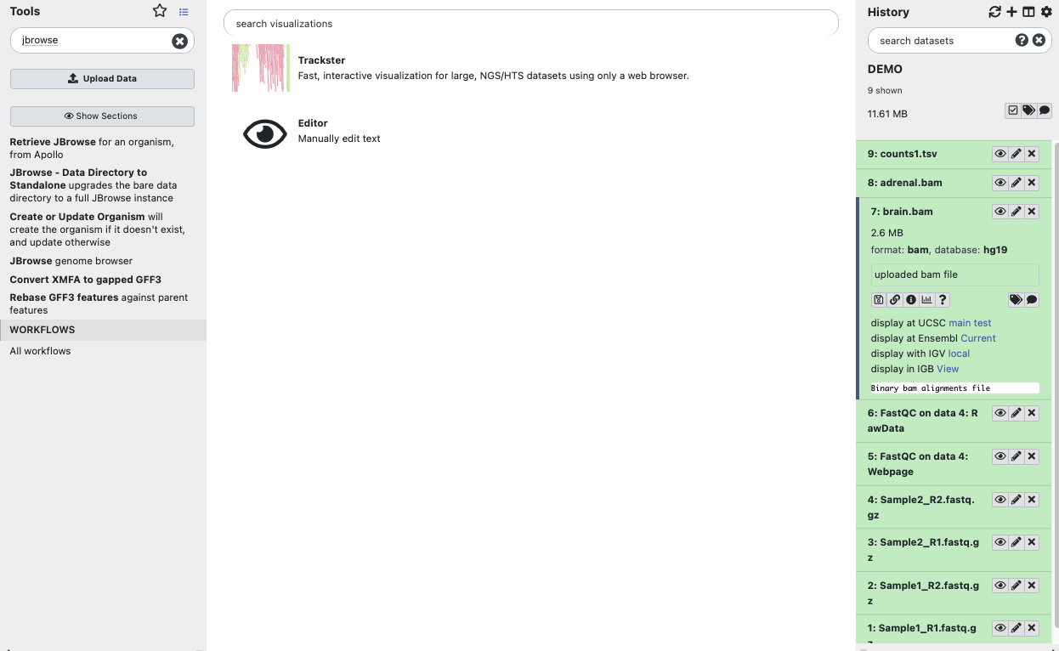
Visualize data
Example of visualize an alignment bam data:
Must have a database (reference genome build). You can build your own custom one
Trackster, JBrowse tool: visualize on the usegalaxy.no server
UCSC, Ensembl: visualize on their servers, only available if the reference genome exists on these servers
IGV, IGB: need to install the software locally

Slide 18
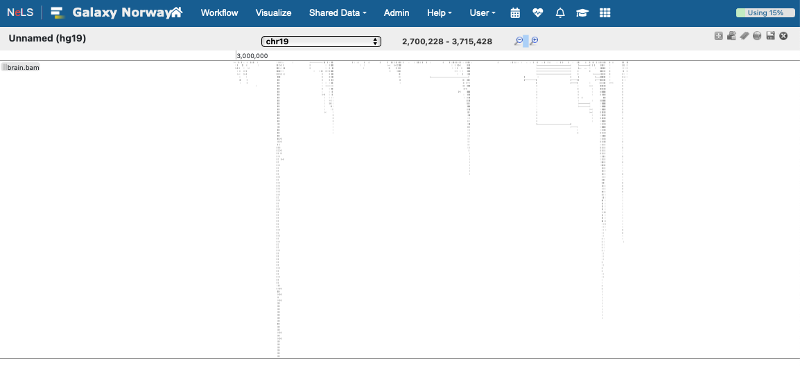
Visualize data
Example of visualize an alignment bam data
- Trackster

Slide 19
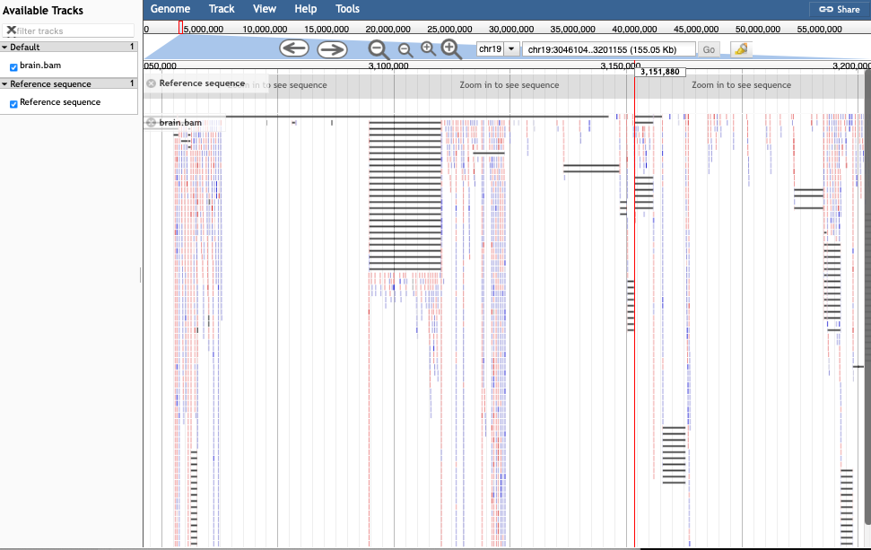
Visualize data
Example of visualize an alignment bam data
- JBrowse

Slide 20
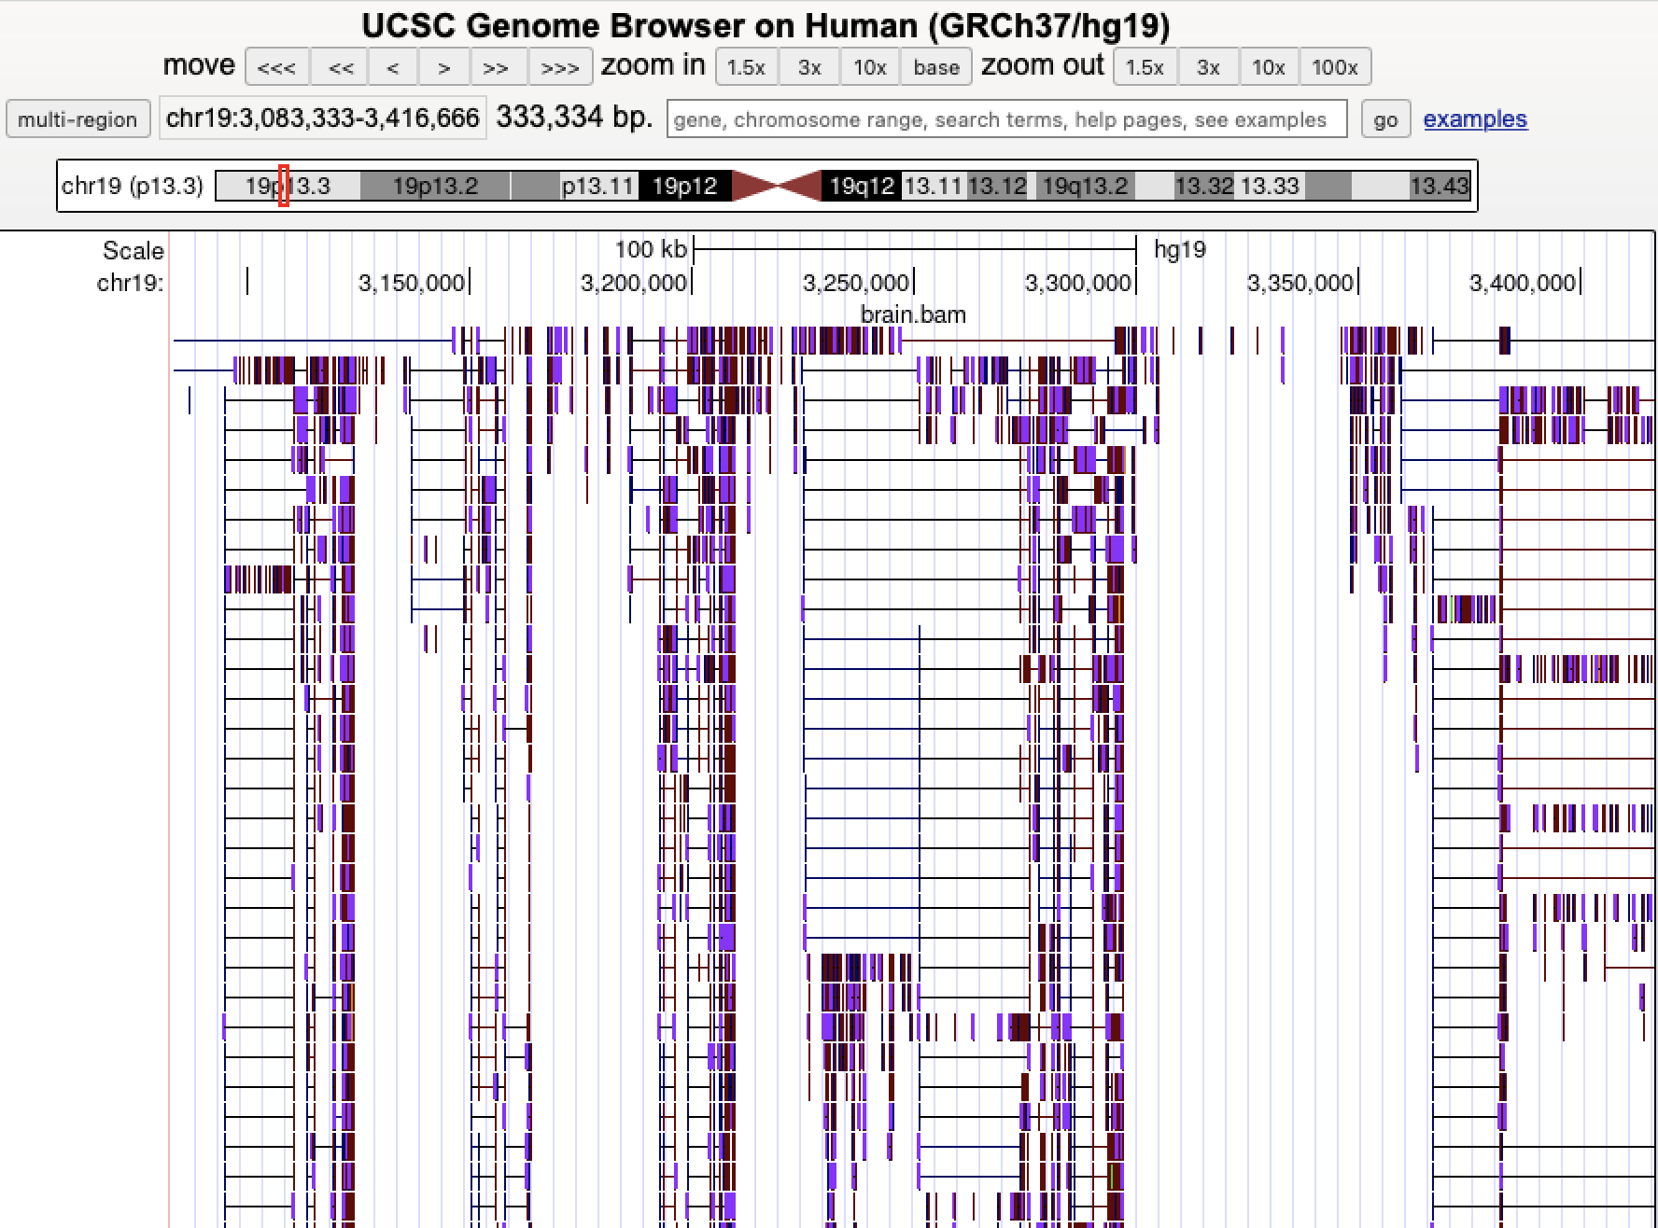
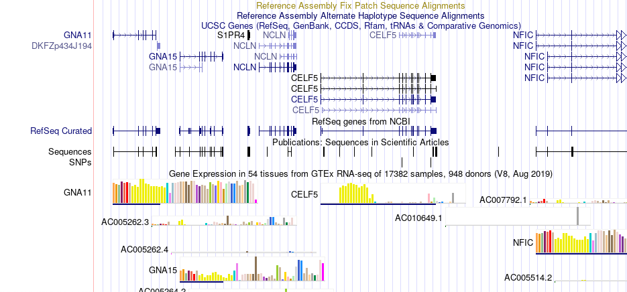
Visualize data
Example of visualize an alignment bam data
- UCSC

Slide 21
Galaxy workflows
A workflow in Galaxy is basically a string of tools, where the output from one tool becomes the input for the next
Tool 1
Tool 2
Tool 3
Output
Output
Output
Notes:
allowing multi-step analyses to be executed as a single unit

Slide 22
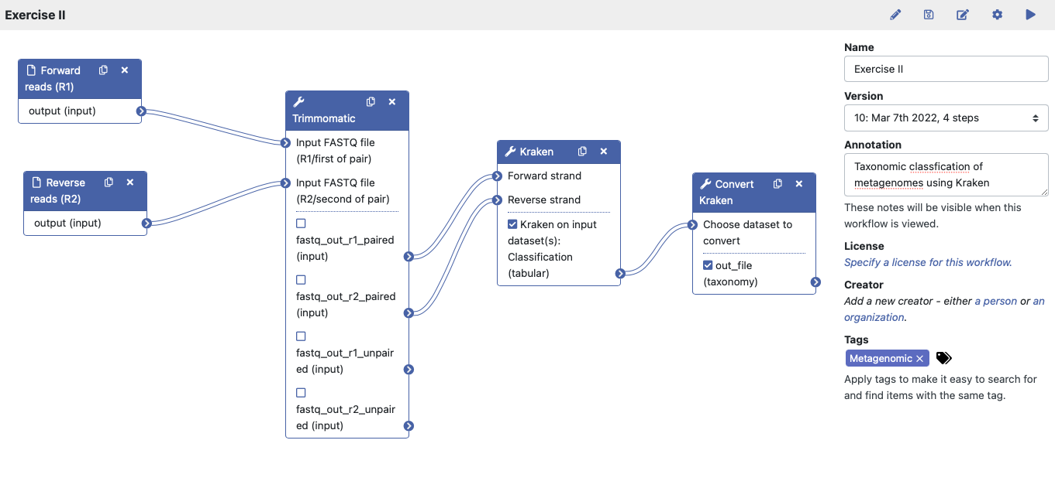
Galaxy workflows
The “nodules” indicate which output file from one acts as input for the next tool
Each workflow has a name and version
Additional text that describe the workflow and tags can be added

Slide 23
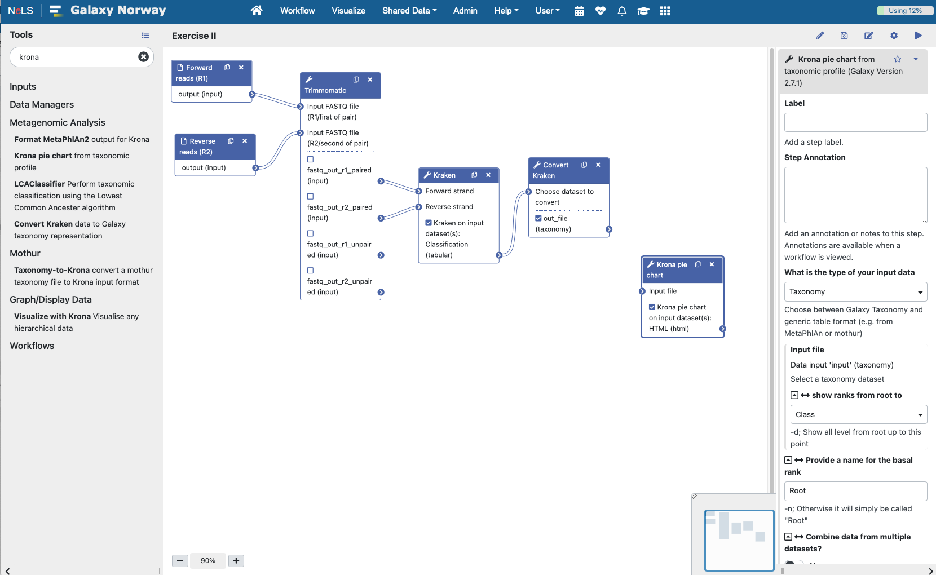
Galaxy workflows
New tools can be added by clicking on the tool in the Tool menu
The tool will appear in the workflow editor

Slide 24


Galaxy workflows
Some tool parameter must be selected when designing a workflow and can not be changed when running
Some tool parameter can be changed:
set in advanced
or set at runtime

Slide 25
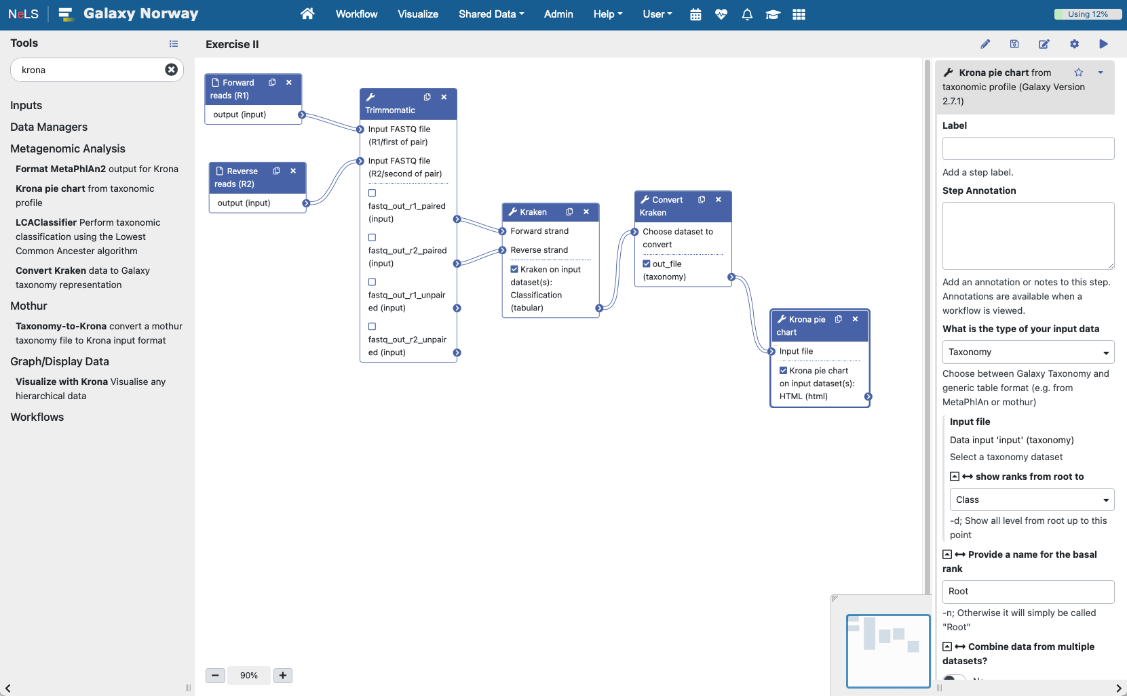
Galaxy workflows
The output from another tools can be connected as an input for the new tool
Can select or unselect output files – unselected output files will be hidden
Remember to save the modified workflow

Slide 26
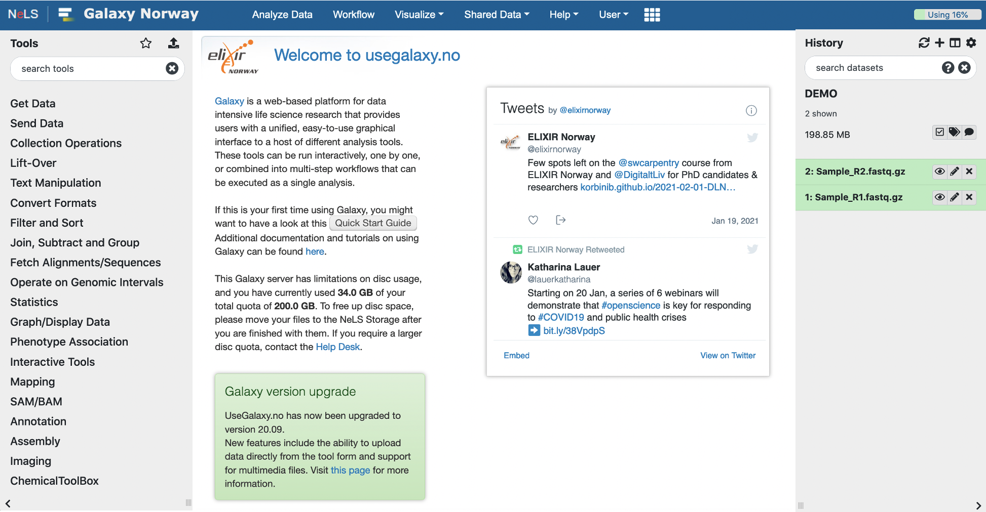
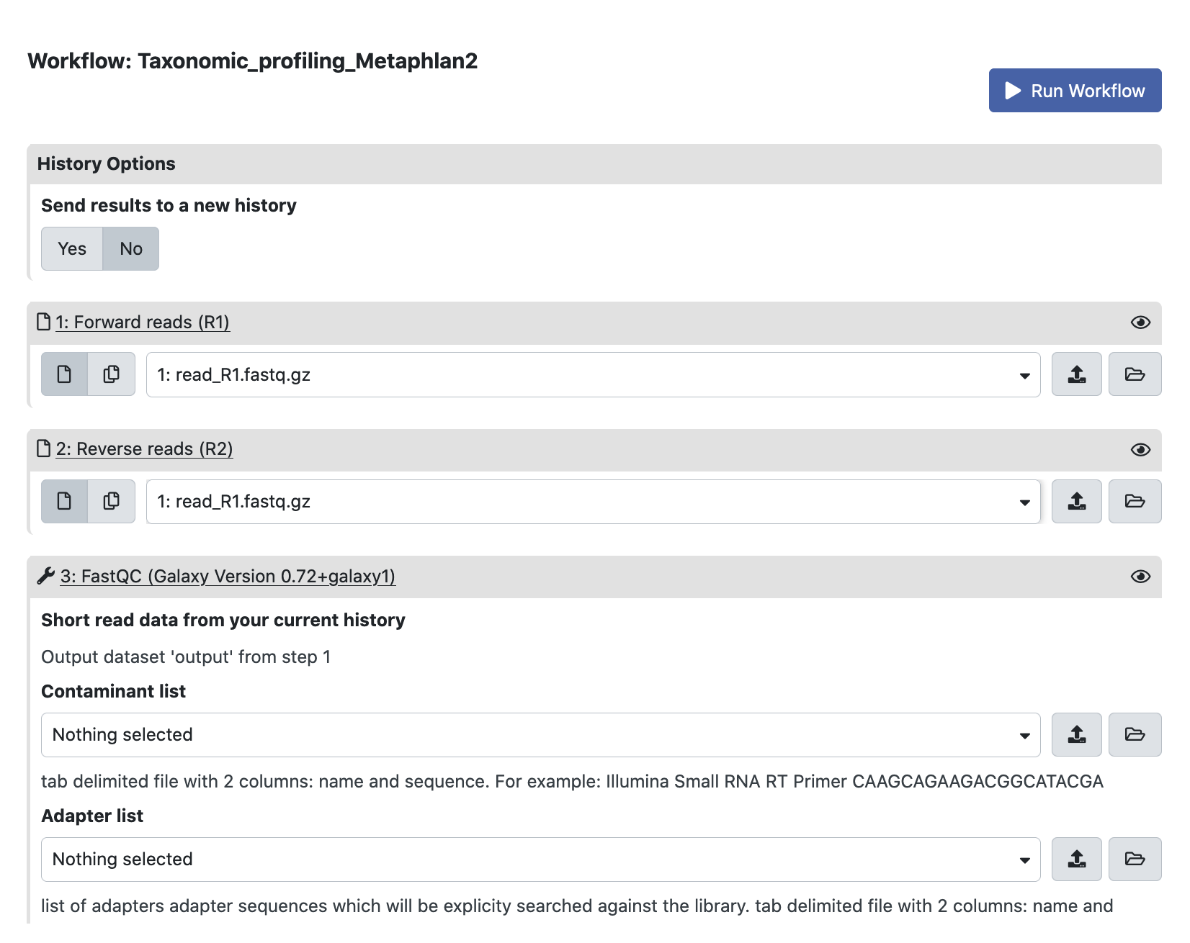
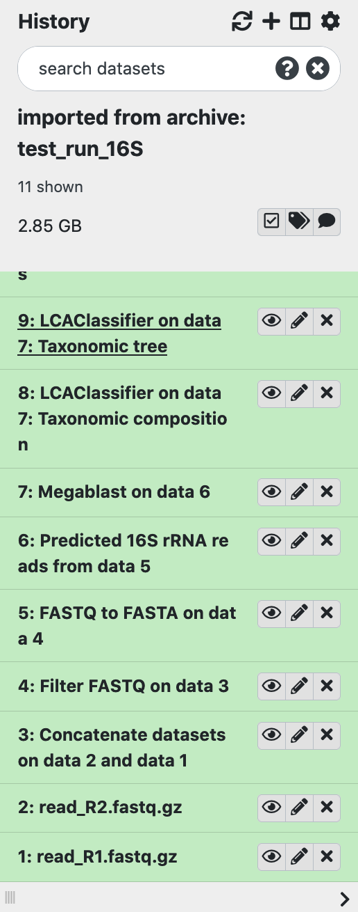
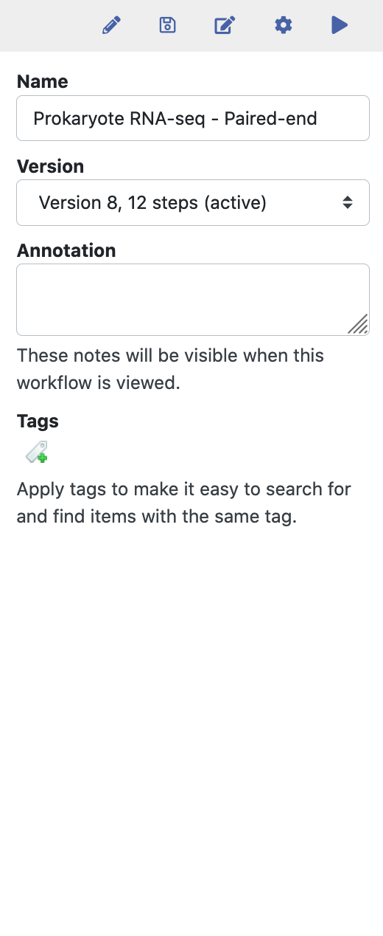
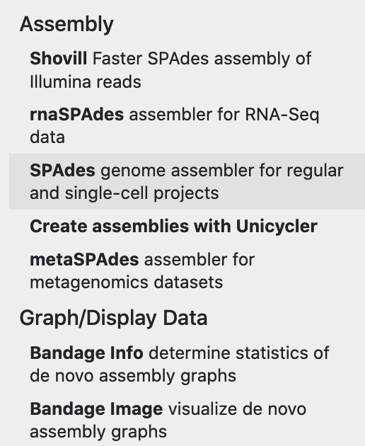
Galaxy – Running workflows
Select input files
Tools in the workflow will run successively
You can view and download the result files

Slide 27
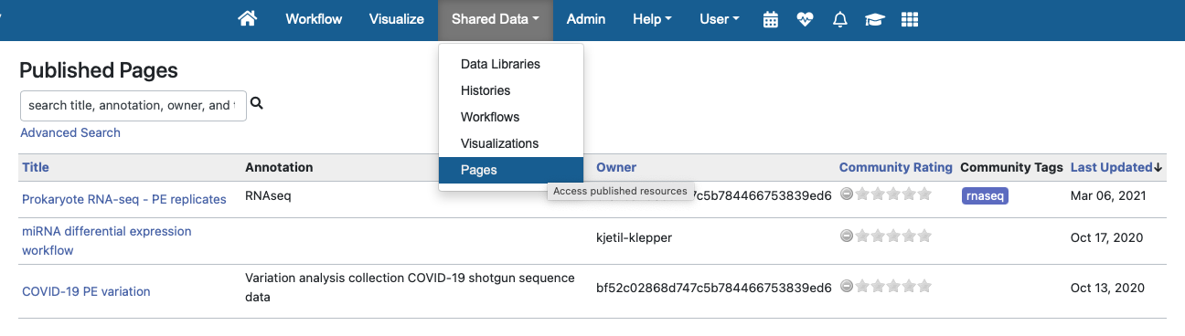
Workflow documentation in Usegalaxy.no
Each NeLS supported workflow is documented with instructions how to use it
Also test data sets available for each workflow

Slide 28
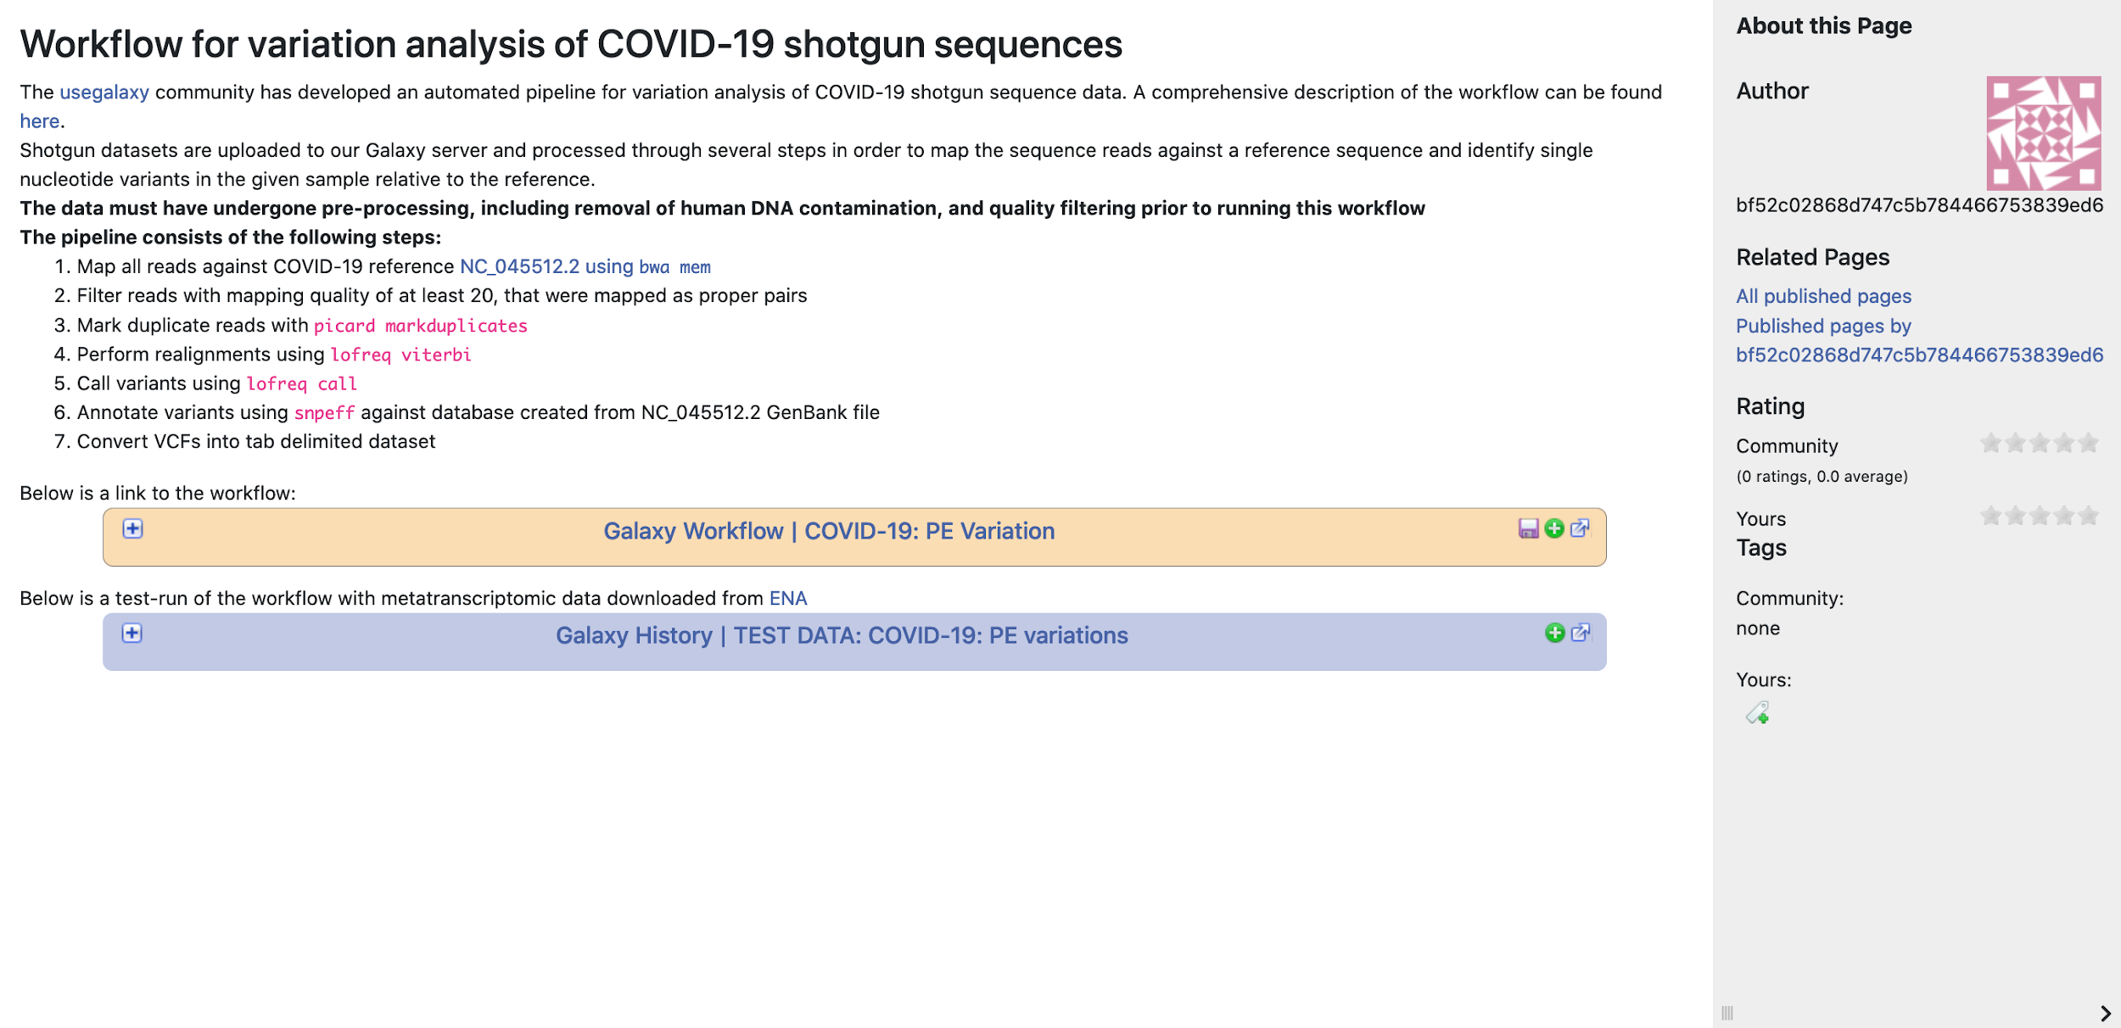
Workflow documentation in Usegalaxy.no
Each NeLS supported workflow is documented with instructions how to use it
Also test data sets available for each workflow

Slide 29
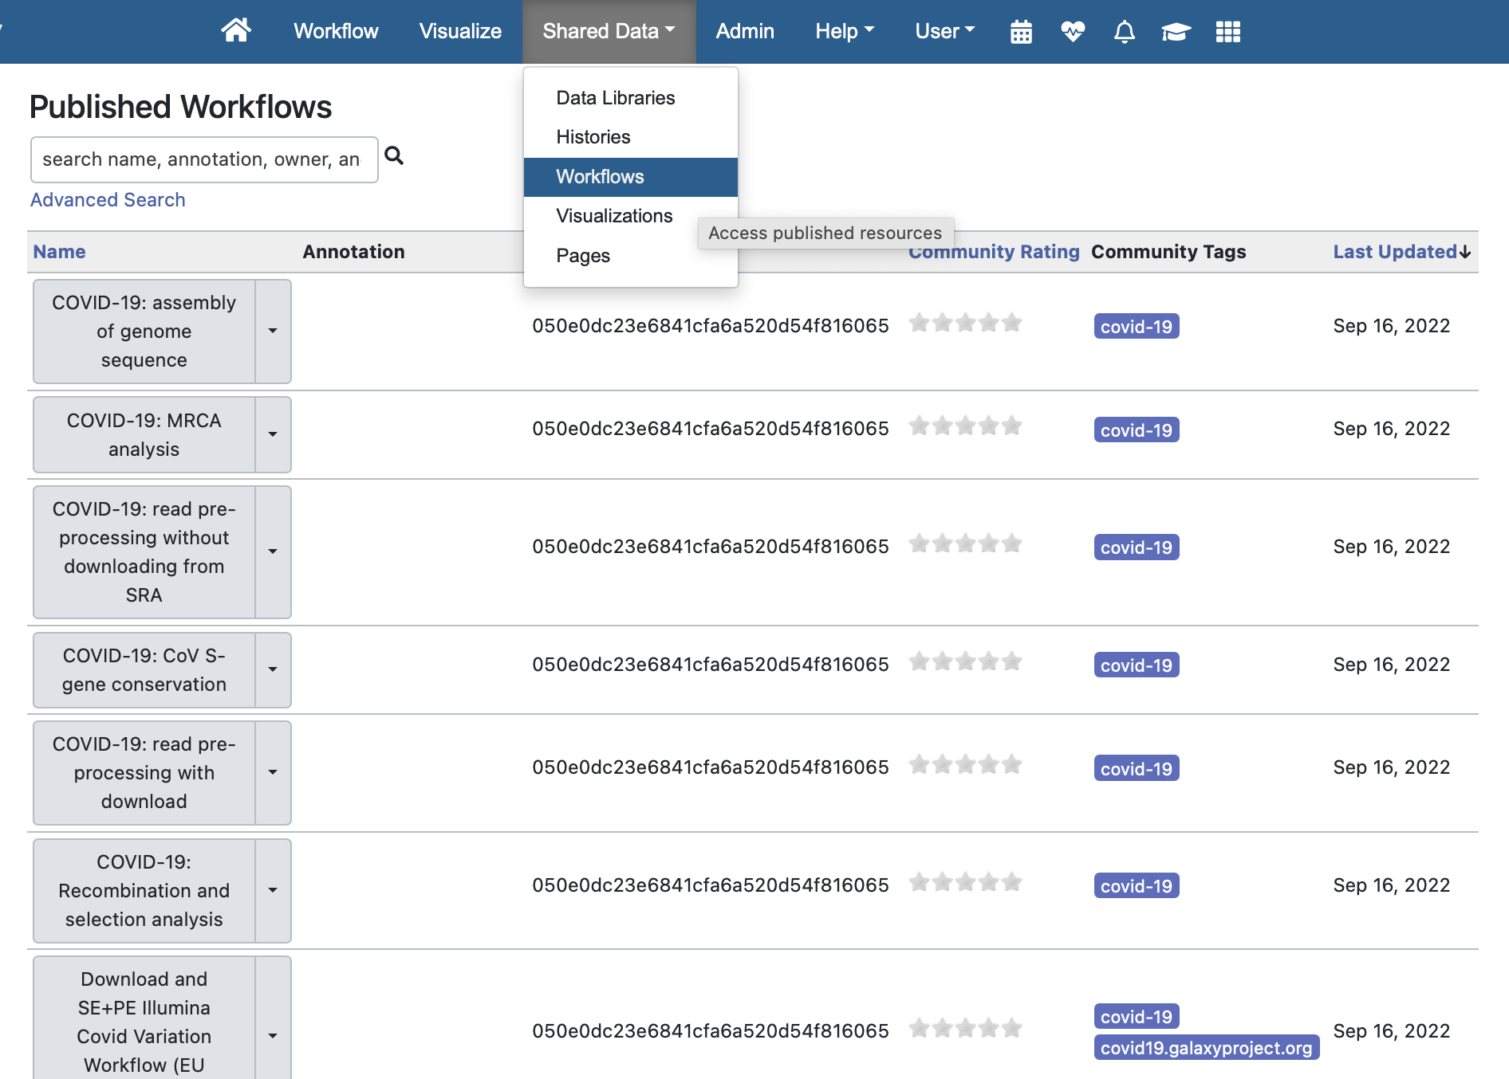
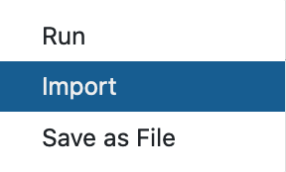
Shared workflows in usegalaxy.no
List of all workflows that are shared with all usegalaxy.no users
You can import shared data to your workspace
By selecting any workflow you can run data analysis, import into your workspace or save it on another computer

Slide 30
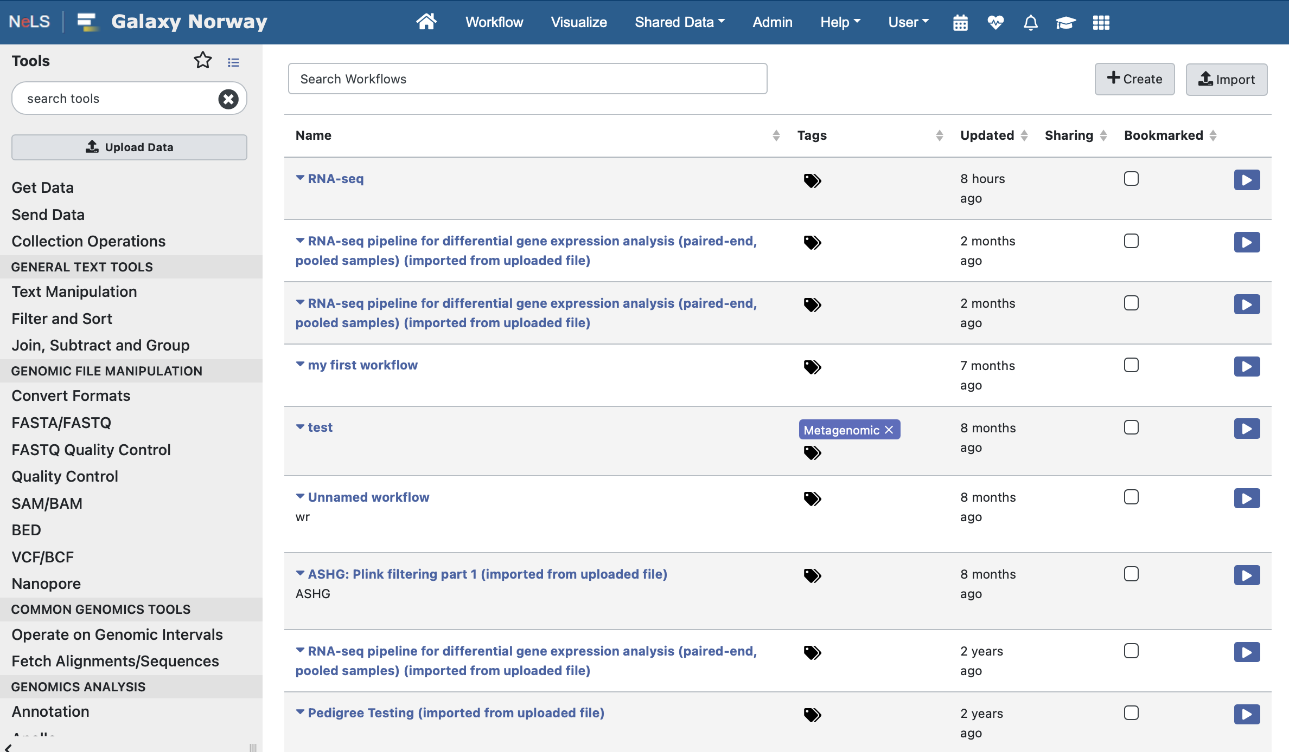
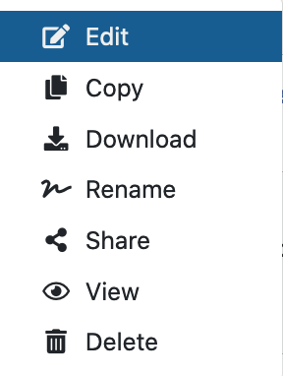
Your imported and self made workflows
You can also create new workflows here
For beginners a good tip is to import an existing workflow, and modify it to meet your needs. The workflow will only be changed in your version

Slide 31
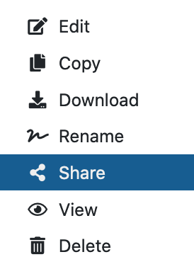
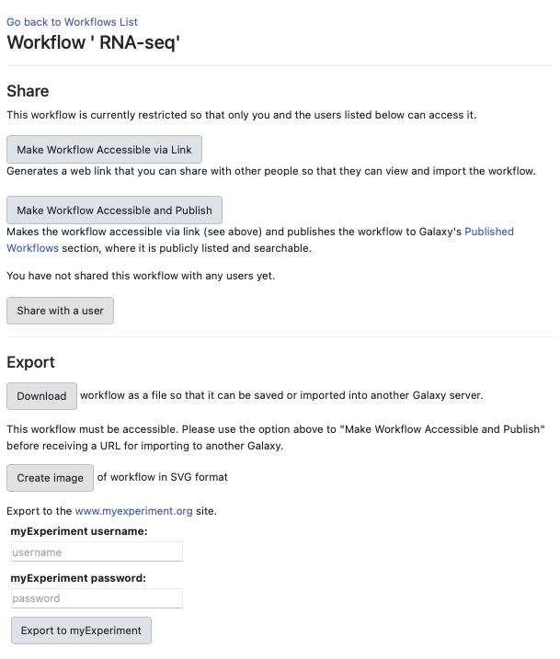
Sharing your workflows in usegalaxy.no
Self made or modified workflows can be shared with other usegalaxy.no users or made accessible via a link
You can also download a workflow and import it in another Galaxy

